Slide 1
Lab 3
Modifying Programs

Slide 2
How to Install Software
Windows
Installshield
Microsoft/Windows Installer
Linux
rpm(Redhat Package Management)
RedHat Linux (.rpm)
apt-get(Advanced Package Tool)
Debian Linux, Ubuntu Linux (.deb)
Good old build process
configure, make, make install

Slide 3
Decompressing Files
Generally, you would get Linux software in the tarball format (.tgz) or (.gz)
Decompress file in current directory:
tar –xzvf filename.tar.gz
Option –x: --extract
Option –z: --gzip
Option –v: --verbose
Option –f: --file

Slide 4
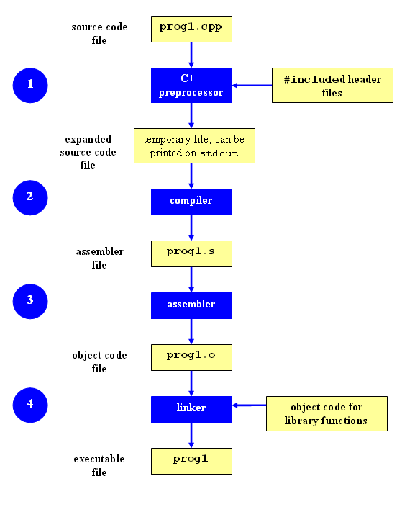
Compilation Process
Compilation

Slide 5
Command-Line Compilation
shop.cpp
#includes shoppingList.h and item.h
shoppingList.cpp
#includes shoppingList.h
item.cpp
#includes item.h
How to compile?
g++ -Wall shoppingList.cpp item.cpp shop.cpp –o shop

Slide 6
What if…
We change one of the header or source files?
Rerun command to generate new executable
We only made a small change to item.cpp?
not efficient to recompile shoppinglist.cpp and shop.cpp
Solution: avoid waste by producing a separate object code file for each source file
g++ -Wall –c item.cpp… (for each source file)
g++ item.o shoppingList.o shop.o –o shop (combine)
Less work for compiler, saves time but more commands

Slide 7
What if…
We change item.h?
Need to recompile every source file that includes it & every source file that includes a header that includes it. Here: item.cpp and shop.cpp
Difficult to keep track of files when project is large
=> Make

Slide 8
Make
Utility for managing large software projects
Compiles files and keeps them up-to-date
Efficient Compilation (only files that need to be recompiled)

Slide 9
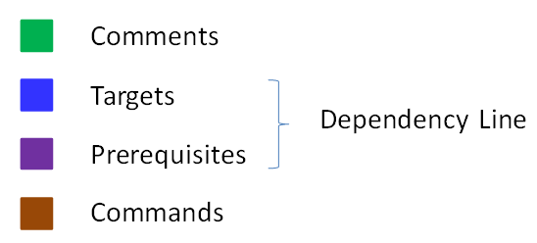
Makefile Example
# Makefile - A Basic Example
all : shop #usually first
shop : item.o shoppingList.o shop.o
g++ -g -Wall -o shop item.o shoppingList.o shop.o
item.o : item.cpp item.h
g++ -g -Wall -c item.cpp
shoppingList.o : shoppingList.cpp item.h shoppingList.h
g++ -g -Wall -c shoppingList.cpp
shop.o : shop.cpp item.h shoppingList.h
g++ -g -Wall -c shop.cpp
clean :
rm -f item.o shoppingList.o shop.o shop
Rule

Slide 10
Build Process
configure
Script that checks details about the machine before installation
Dependency between packages
Creates ‘Makefile’
make
Requires ‘Makefile’ to run
Compiles all the program code and creates executables in current temporary directory
make install
make utility searches for a label named install within the Makefile, and executes only that section of it
executables are copied into the final directories (system directories)

Slide 11
Lab 3
Coreutils 7.6 has a problem
Different users see different date formats
ls –l /bin/bash
-rwxr-xr-x 1 root root 729040 2009-03-02 06:22 /bin/bash
-rwxr-xr-x 1 root root 729040 Mar 2 2009 /bin/bash
Why?
Different locales
Want the traditional Unix format for all users
Fix the ls program

Slide 12
Getting Set Up (Step 1)
Download coreutils-7.6 to your home directory
Use ‘wget’
Untar and Unzip it
tar –xzvf coreutils-7.6.tar.gz
Make a directory coreutilsInstall in your home directory (this is where you’ll be installing coreutils)
mkdir coreutilsInstall

Slide 13
Building coreutils (Step 2)
Go into coreutils-7.6 directory. This is what you just unzipped.
Read the INSTALL file on how to configure “make”, especially --prefix flag
Run the configure script using the prefix flag so that when everything is done, coreutils will be installed in the directory ~/coreutilsInstall
Compile it: make
Install it: make install (won’t work on Linux server without proper prefix!)

Slide 14
Reproduce Bug (Step 3)
Reproduce the bug by running the version of ‘ls’ in coreutils 7.6

Slide 15
Patching
A patch is a piece of software designed to fix problems with or update a computer program
It’s a diff file that includes the changes made to a file
A person who has the original (buggy) file can use the patch command with the diff file to add the changes to their original file

Slide 16
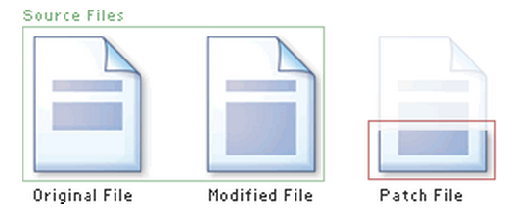
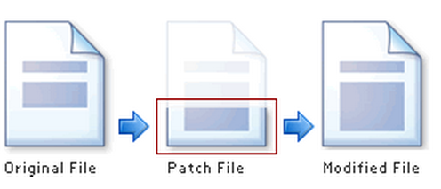
Applying a Patch

Slide 17
diff Unified Format
diff –u original_file modified_file
--- path/to/original_file
+++ path/to/modified_file
@@ -l,s +l,s @@
@@: beginning of a hunk
l: beginning line number
s: number of lines the change hunk applies to for each file
A line with a:
- sign was deleted from the original
+ sign was added to the original
stayed the same

Slide 18
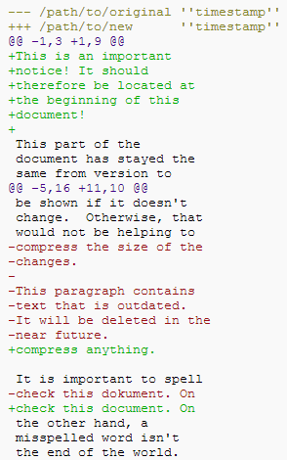

Slide 19
Patching and Building (Steps 4 & 5)
cd coreutils-7.6
vim or emacs patch_file: copy and paste the patch content
patch –pnum < patch_file
‘man patch’ to find out what pnum does and how to use it
cd into the coreutils-7.6 directory and type make to rebuild patched ls.c. Don’t install!!

Slide 20
Testing Fix (Step 6)
Test the following:
Modified ls works
Installed unmodified ls does NOT work
Test on:
1) a file that has been recently modified
Make a change to an existing file or create a new file
2) a file that is at least a year old
touch –t 201401210959.30 test_file
Answer Q1 and Q2

